Slide 1

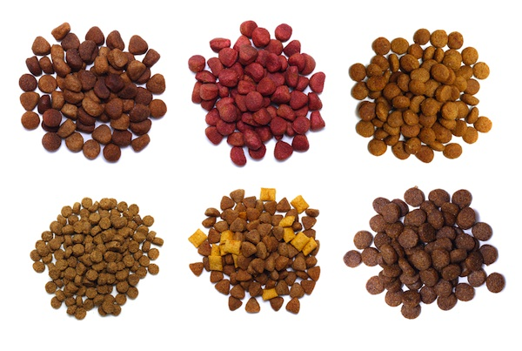
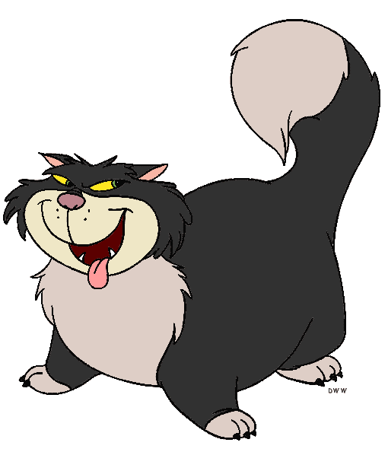

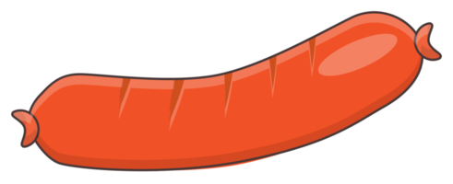
Doggo / Nogo
A Modern Additive Cognitive Control Paradigm for Computational Neuropsychology

Slide 2
Goal:
Develop an engaging, reliable, comprehensive paradigm for cognitive control
To be used as an neuropsychological index (correlate with other processes / assessment)
To be used to investigate the role of interoceptive mechanisms

Slide 3
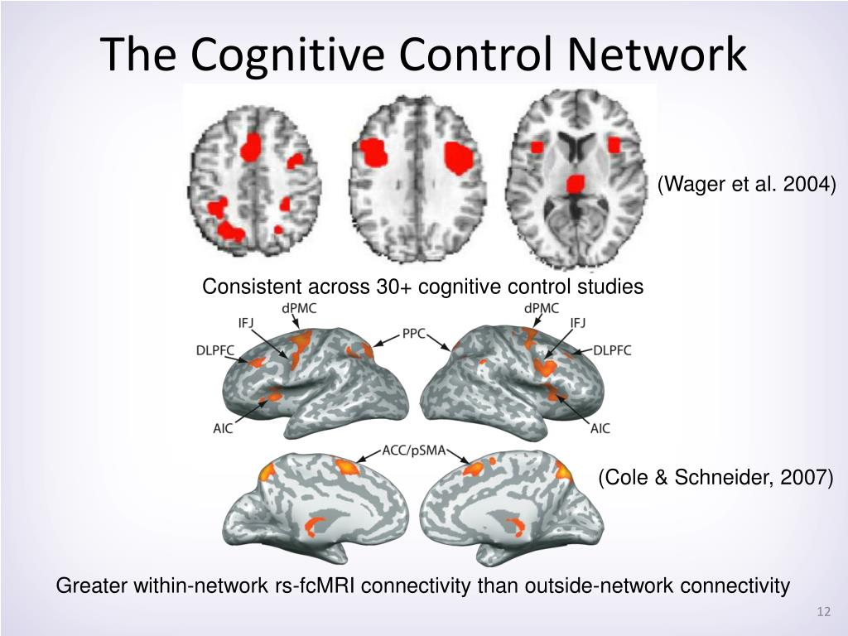
Why?
Cognitive Control
« Cognitive Control » is a critical cognitive function and its impairment a transdiagnostic symptom
It is not a unitary construct but refers to a variety of mechanisms
Processing speed, attention control
Inhibition (motor inhibition, response inhibition, …)
Conflict (conflict monitoring, conflict resolution, …)
Mental set shifting (task rules inhibition and switching…)
Working memory (short term memory, updating, …)
Multiple tasks exist to measure them (Stroop, flanker, Simon, Go/Nogo, Stop-signal, ANT, …)
Problem
Low psychometric-to-behavior predictive power
Low correlation between various tasks
Low reliability of tasks
Large samples with comprehensive batteries difficult
Solution(s)
Better analysis approaches (e.g., mixed models, decision making models – aka « Sequential Sampling Models »)
More engaging tasks (gamification?)
More controlled manipulations (better « control » conditions, etc.)
More systematic and sequential (additive) quantification procedure

Slide 4
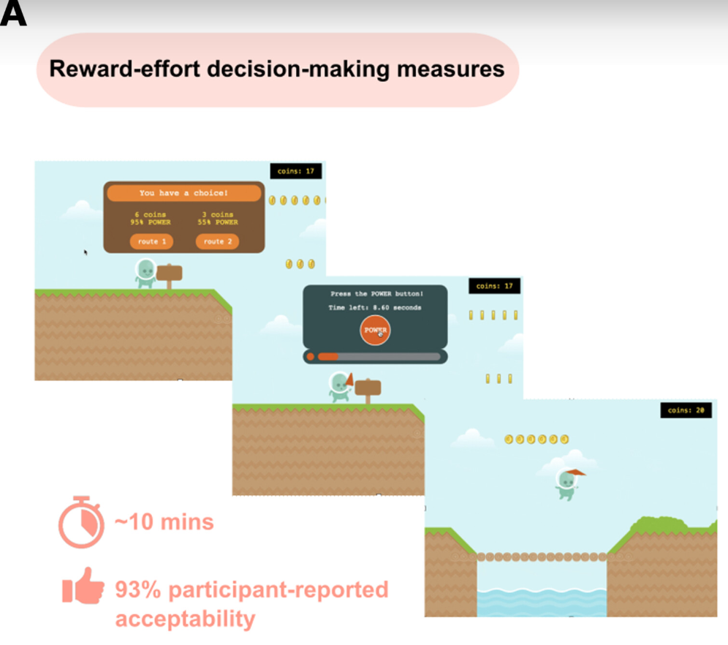
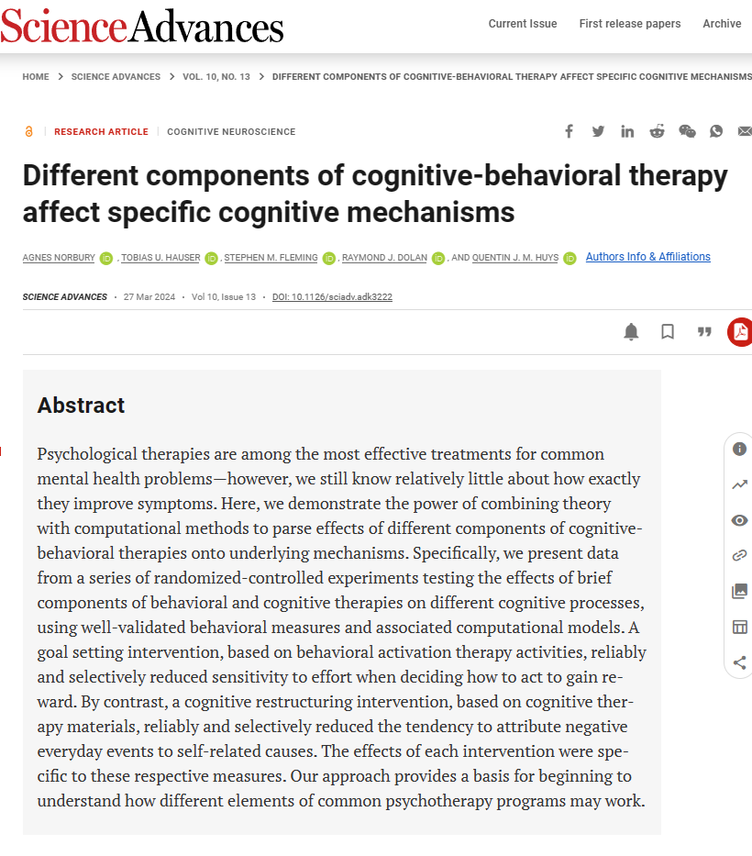
Gamification
Gamification != pretty graphics
Graphics does not predict sense of presence
Gamification = mechanisms that make it enjoyable and addictive
Pleasure and reward: dopaminergic system
Doggo / Nogo key mechanisms
Competitive aspect
“Leaderboard”: feedback on performance compared to others
Sense of progression
Score + “evolutions”
Narrative aspect
Compelling story that makes the game cognitively “fluid”
Examples
https://github.com/agnesnorbury/cognitive-mechanisms-psychotherapy?tab=readme-ov-file

Slide 5
Systematic Additive Paradigm
Many neuropsychological tasks are based on the « substractive » paradigm
Contrast of 2 conditions (e.g., incongruent – congruent)
Good but issues with reliability
Cronbach’s merger
Solution: Systematically measure the baseline proficiency
Baseline Proficiency
Target condition
(e.g., « conflict » or « incongruent »)
Target mechanism + Random processes
+ Context?
Control condition
(e.g., « congruent »)
Random processes
+ Context?

Slide 6
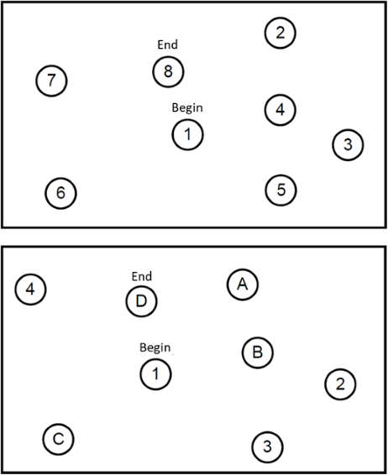
Processing Speed
Motor (speed + precision)
Visuospatial exploration
Strategy
Contextual (e.g., hiding a number with arm)
Processing Speed
Motor (speed + precision)
Visuospatial exploration
Strategy
Contextual (e.g., hiding a number with arm)
+ Flexibility
In theory, TMT B – TMT A = Flexibility
In reality, all of the contributing factors are sources of noise
Large test-retest variability
In practice: (TMT B + noise) – (TMT 1 + noise) = Flexibility + noise x 2
This one of the main driver of the « reliability crisis » in neuropsychological measurement

Slide 7
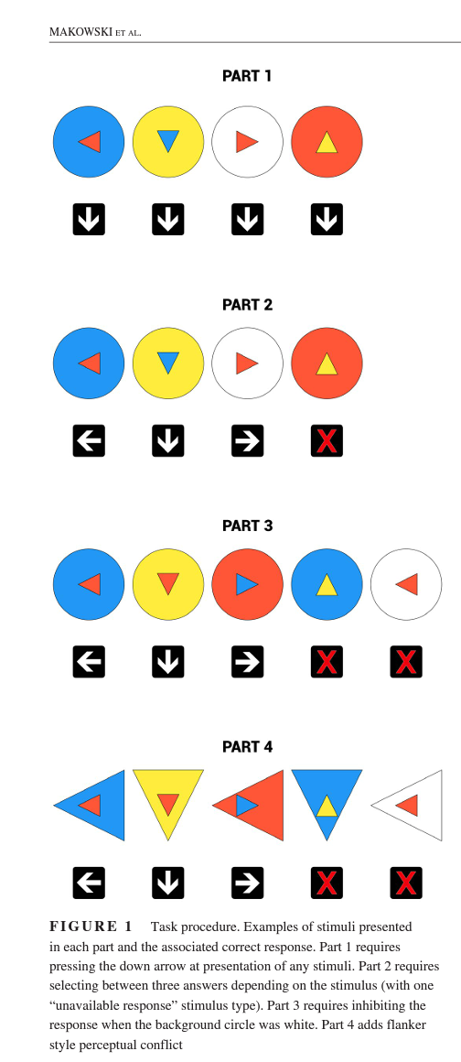
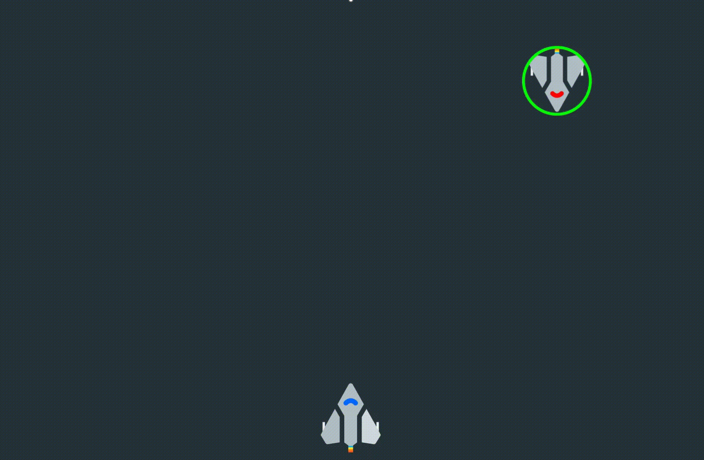


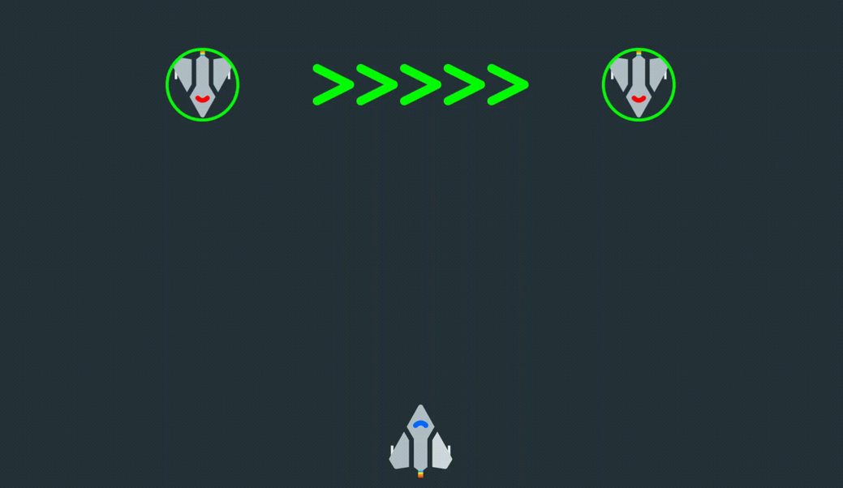
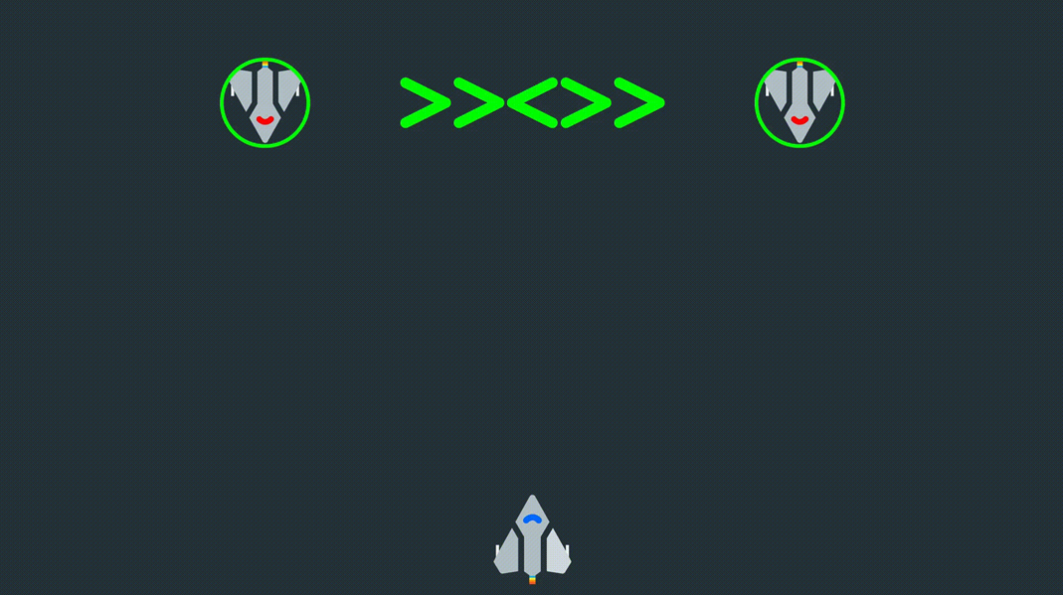
How?
Cognitive Control Task v1 (Cocon)
Sequential and additive decomposition mechanisms
Part 1: Processing Speed
Simple reaction time task
Part 2: Response Selection
Congruent response choice
Part 3: Response Inhibition
Go/No Go Paradigm
Part 4: Conflict Resolution
« Flanker » Paradigm
Issues
Amount of trials
Not engaging
Cognitive Control Task v2 (Star Control)
Narrative Context
Phase 1: Processing Speed
Phase 2: Response Selection
Phase 3: Stop Signal Task
Phase 4: Flanker
Issues
Static
Not online

Slide 8
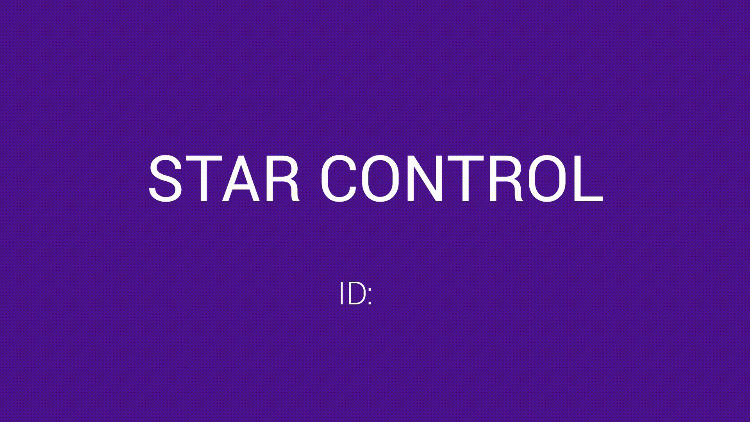

Slide 9
Doggo / Nogo
« Real » user Game (score, levels, scoreboard, …)
Online
Engaging engough for self-engagement (big data?)
Outcomes
Better understand the unicity/diversity of CC tasks
Suited for wide range of ages & conditions
A unified framework for evaluating various aspects of CC
Story idea
We rescue a dog (named « Doggo ») and need to feed him.
But the cat (« Nogo ») is jealous?
Intro video with static images
Challenges
Art (AI? Collab with artists? But placeholders)
Animations
Backend (Data collection, storage, re-playability)

Slide 10
Menus
Start screen
Start a New Game
E-mail address
Age
Gender
Already played?
E-mail address
Continue
Start a New Game
Read Terms & Conditions
Need for a mention « by playing, I accept the terms & conditions »
About
Description, contact, etc.

Slide 11
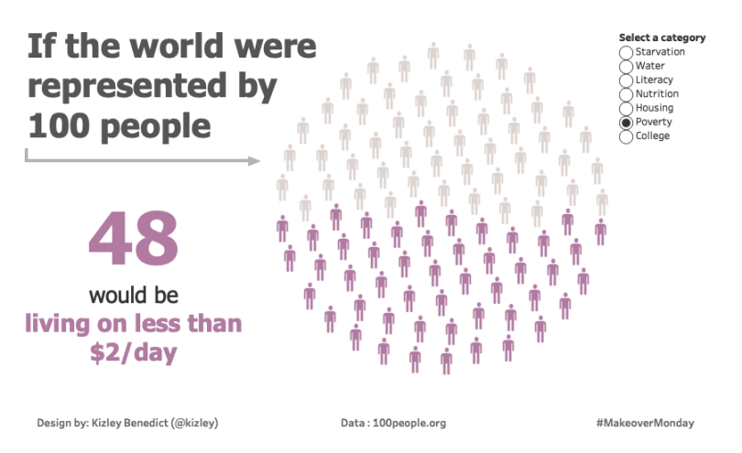
Score and End Screen
Marketing
Test your brain
Train your brain*
Fluid intelligence is a key symptom of many psychiatric disorders… preserve it
Cognitive training / rehabilitation is a validated procedure used in neuropsychology
General final score (« leaderboard »)
Score number + chart
Relative to the population: auto-updated from the database?
+ score by levels?
If score too low, do not display comparison chart, but instead tips on how to do better?
Replay button
Can jump to specific level
Provides a code that can be copied (to be used in other studies, e.g., prolific & lab-studies)

Slide 12
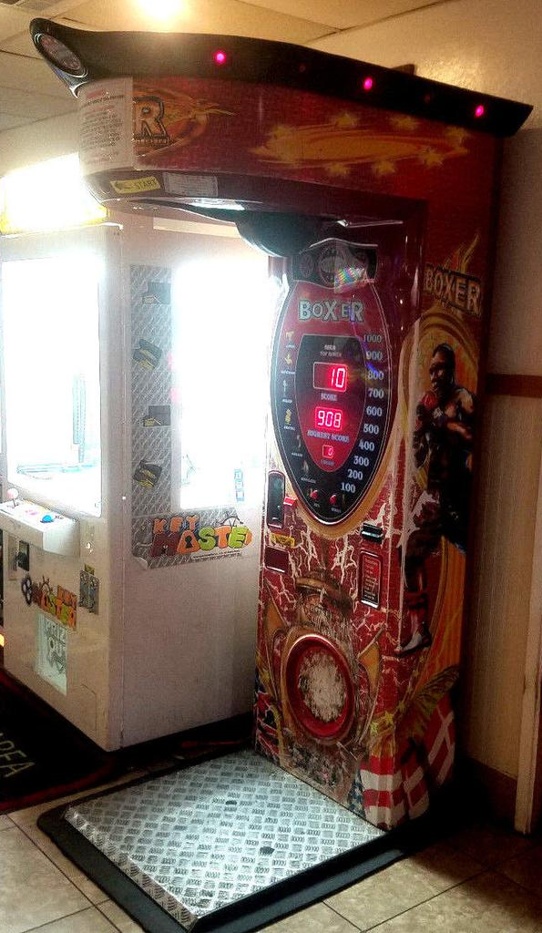
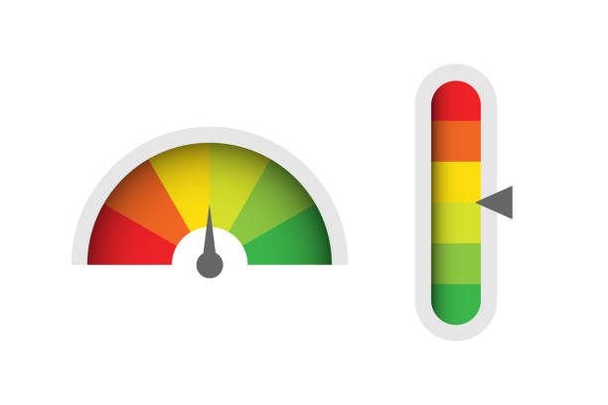
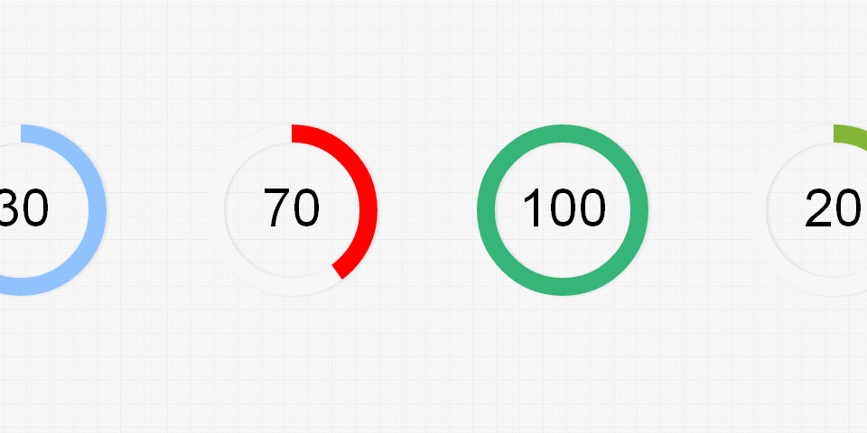
Level 1: Simple Reaction Time
457
3 blocks
The dog sprite « evolves » between each: Rewarding aspect
From malnourished skinny dog to majestic shiny one
Animation
« Warf » when button is pressed fast enough (e.g., < average) with dog smiling (Positive feedback)
Groan if slow answer with dog being like « :S »
Stimuli gets « bad » over time (speed of animation depends on the distribution of participant’s RTs, e.g., 95% ETI, or 2*average)
Score gets updated with a color gradient that depends on the speed (same underlying variable controls the color of the score update and the aspect of the stimulus)
End scree
Score (IES) increases alongside a bar that gets filled up following the percentile score
457
457

Slide 13
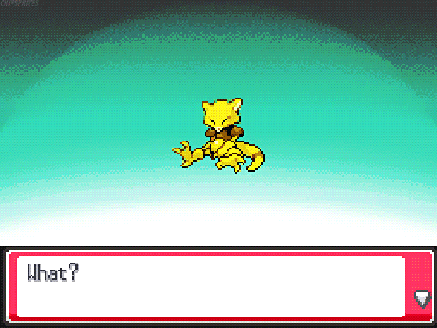



Score computation
Score starts at 0
If « Positive » trial (RT <= Threshold), score increases
+ log(1 + |Threshold – RT|)
If « Negative » trial (RT <= Threshold), score decreases
- log(1 + | Threshold – RT|)
Score udpate is multiplied by RT so slow RT are penalized (regardless of the difference)
Have a maximum treshold (~600 ms?) to avoid cheating
Early responses are penalized (- score) and lead to a restart of the ISI
Character evolution
Depending on score
Shiny dog 1: score [100, 1000]
Default dog: score [-100, 100]
Malnourished dog: score [-1000, -100]
When new range is reached, make « evolution » screen

Slide 14
Score & Number of trials
Adjust number of trials based on efficiency on previous bloc
Task is set to N=60 trials; Score range for fast trial is (+100-200)
= 60 /3 = 20 trials per stage
= 20/2 = 10 fast trials per stage
Default score for fast trial = +100
Score goal for 1st stage is set to 100 (score) * 10 (fast trials) = 1000
Assume that they are very efficient (always hit below the threshold) and reach the first stage after 12 trials.
Next 2 stages are set to 60-12=58 trials
58 / 2 = 29 trials per stage = 14.5 fast trials
Score goal for 2nst stage is 100*14.5 = 1450
Assume that they are slow and reach the stage after 35 trials
Final stage is set to 60 – (12 + 35) = 13 (note that there is a minimum of e.g., 10, see below)
13 / 2 = 6.5 fast trials
Score goal for the final stage is 650
Note: must be a minimum number of trial per stage
If people reach the target N trials during stage 2
e.g., 10 min. trials = 10/2 = 5 * 100 = 500 score minimum for a stage
Score calculation
Set score range [+100, +200]
Minimum score for « fast » trial= +100
Max score for super fast trial = +200
Score for early trial = -100 (flat rate)
Score for « slow » (> threshold) trial = +0
Modifier:
1. Get relative RT
Set minimum/maximum RT bounds [200 – 600 ms]
Trial RT is 470 ms
Compute normalized distance from min bound
(RT – lowbound) / (highbound - lowbound)
(470-200) / (600-200) = 270 / 400 = 0.675
If relative RT < 0, =0; if > 1, = 1
Reverse: relative RT = 1 – 0.675 = 0.325
2. Transform to score bonus
Max score bonus is max score – min score = 200 - 100 = 100
Relative RT * Max score bonus = 0.325 * 100 = 32.5
Score = min score + score bonus = 100 + 32.5
Score = +132.5
1000
1000
1450
1000
1450
650

Slide 15
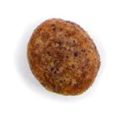
Level 2: Motor Response Choice
457
Level 2a: Response Choice – Association creation
Same as previously but different sprites / animations / sounds
Random color association
Cheese shape?
Fish color/shape (Nogo is japanese and loves sushi)
Level 2b: Response Choice – Associative
Level 2c: Response Choice conflit : Simon task
457
Conflict
457
457
457
457

Slide 16
Level X: Response Inhibition (Stop signal)
457

Slide 17
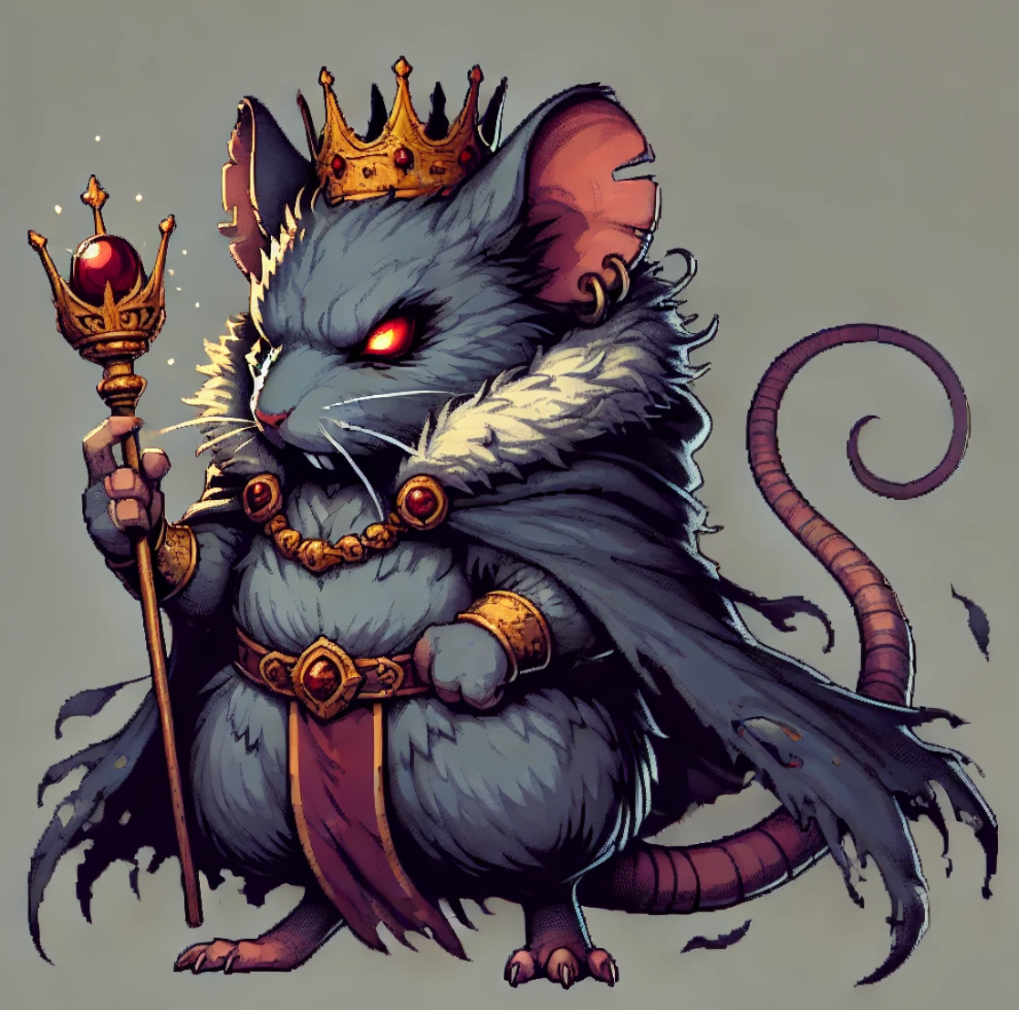
King of the mice declares war on Nogo!

Slide 18
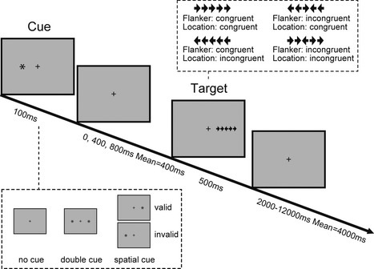

Level X: Attentional Control (ANT)
Conditions
No cue
Uninformative cue
Valid cue
Incongruent cue
457
457
457

Slide 19
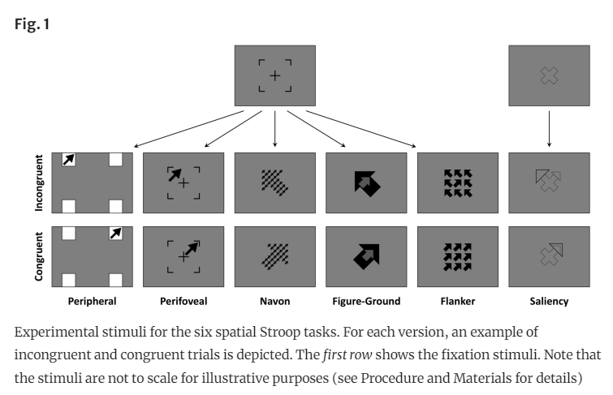
Level X: Perceptual Control (Flanker)
Conditions
Varying degrees of conflict
Double shot condition (Kucin, …, and Heathcote, 2023)
Diagonal? (double response = up + right)
« Spatial stroop » (Viviani et al., 2023)
Perifoveal is the best

Slide 20
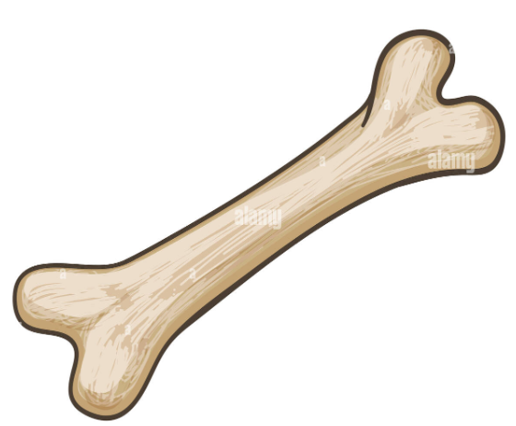
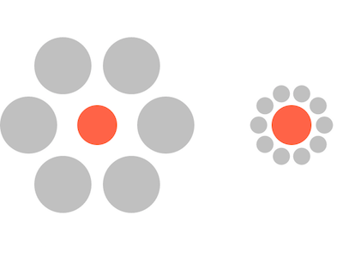
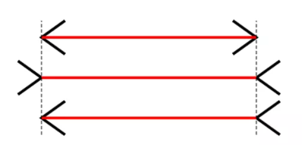


Level X: Perceptual Control (Illusion)

Slide 21

Level X: Working Memory

Slide 22
Storyboard
Intro: Rescuing sad Doggo from a shelter
Level 1 (Simple RT): Doggo gets fed and becomes fat
Level 2 (Motor decision): Introducing Nogo
Level X (Stop signal): Doggo is too fat and starts a diet
…

Slide 23
Processing Speed
Fundamental cross-domain « ability » (« fluid intelligence »)
« ability » per se vs. enabler of efficiency
Permeates most cognitive tasks
Can be measured as such with simple reaction time tasks
Rarely assessed as such. Why?
Boring and long tasks
Aspecific cognitive mechanism
Is measured concurently in any tasks with response time / time constraint
Psychologists typically interested in higher-order mechanisms
Even if processing speed is not the focus of interest, isn’t it important to measure it to « control » for processing speed differences?
Neuropsychological framework of « contrast » paradigm
Cronbach’s merger (Rouder)
Issue: Amplifies noise

Slide 24
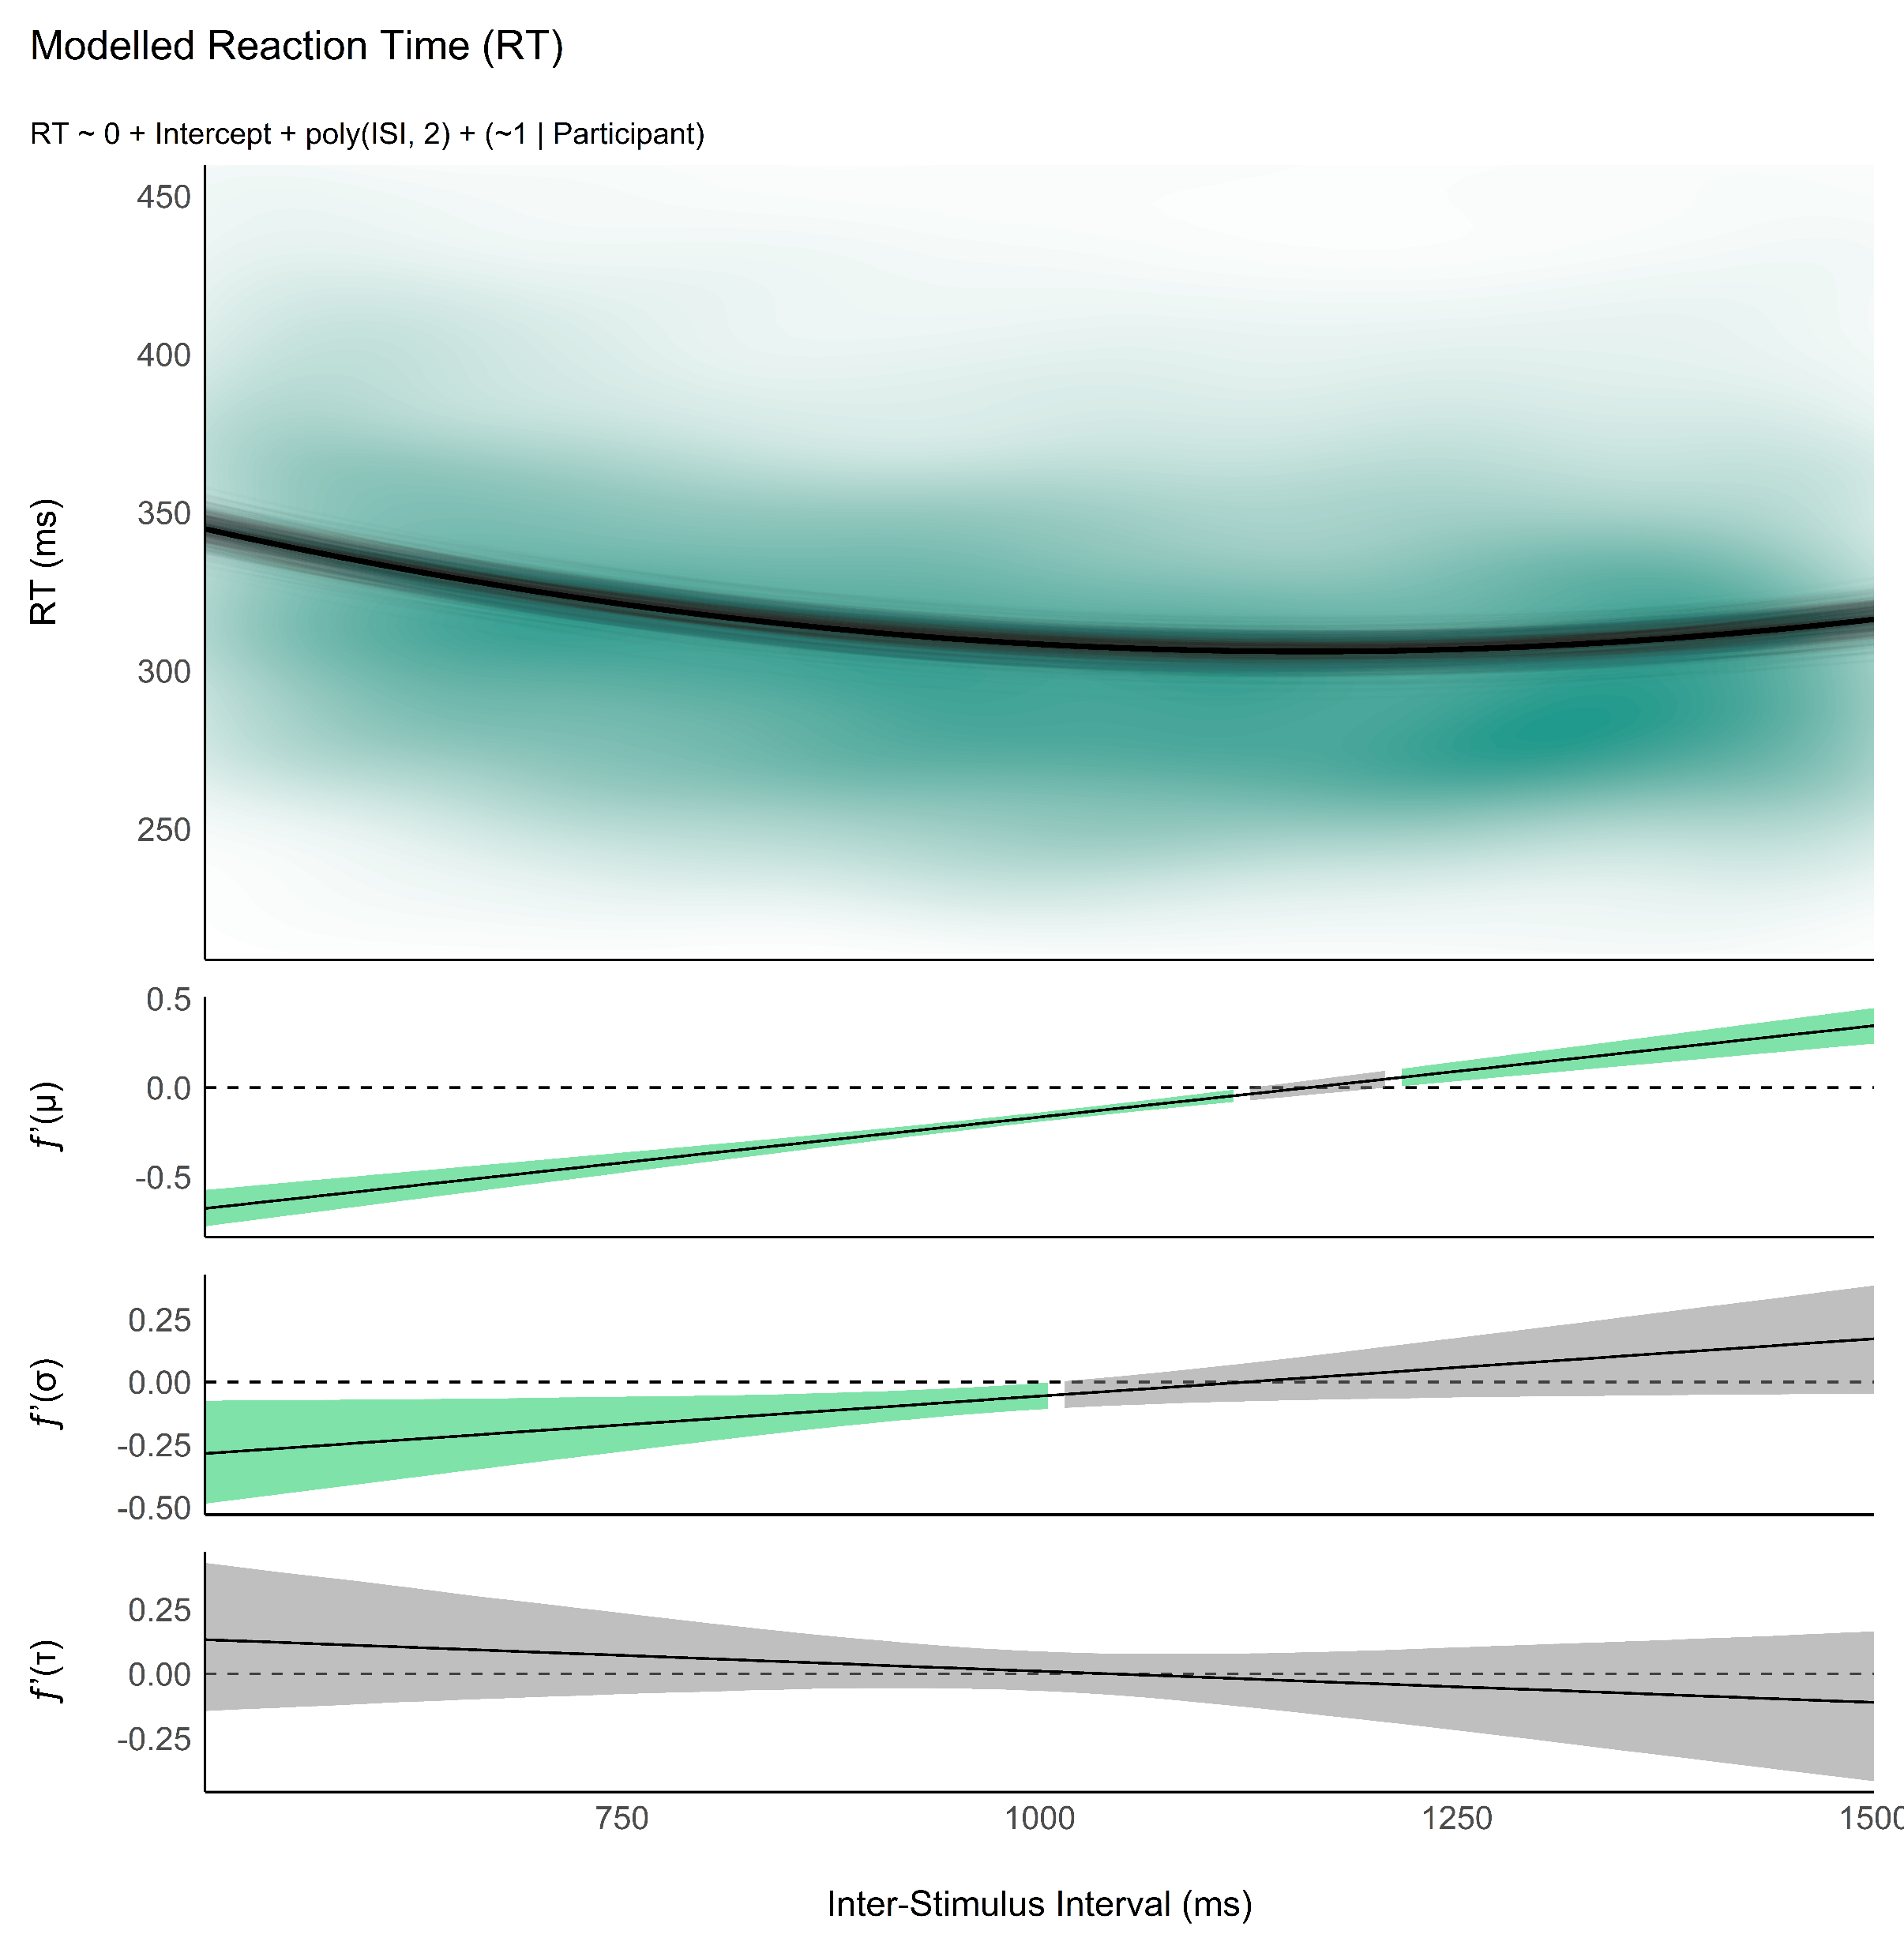
Study 1a: Development of the Optimal Simple RT Task
Reliability - How many trials?
Run experiment with high number of trials
Analyze convergence of estimates
Analysis
Optimal model: LBA? Wald? LNR? DDM?
Ancillary project
Optimal priors for individual SSMs from group-level
Effect of ISI
Important that participant are in optimal conditions when doing an RT task to be as fast as they can
Variable ISI is important to prevent planned / rythmic responding
But short / large ISI can impact RT characteristics (+ differently for different people)
What is the optimal ISI window?
Measure minimum of U effect in each participant
Define the best ISI range (95%) to capture that minimum

Slide 25
Study 1b: Validation of the Optimal Simple RT Task
Gamification
Compare gamified vs. Stripped RT task
Questions about duration perception « how long did you play for? »
« How much would you be annoyed if you had to do the task again? »

Slide 26
Studies
Study 1: Statistical power - How many trials in each phase
Run experiment with high number of trials
Analyze convergence of estimates
Study 2: Reliability
Test retest
Improved reliability via prediction of estimates based on other scores (e.g., simple RT)
Study 3: Validity
Clinical groups (ADHD)? Aging?
Personality
IQ / Fluid intelligence
Emotion regulation
Neurophysiological Determinants
Cardiac phase
HRV correlates
EEG

Slide 27
The Process

Slide 28
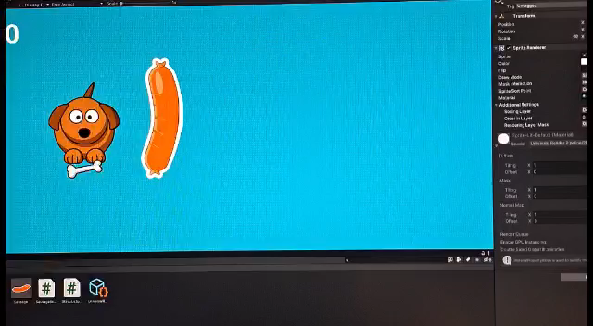

Slide 29

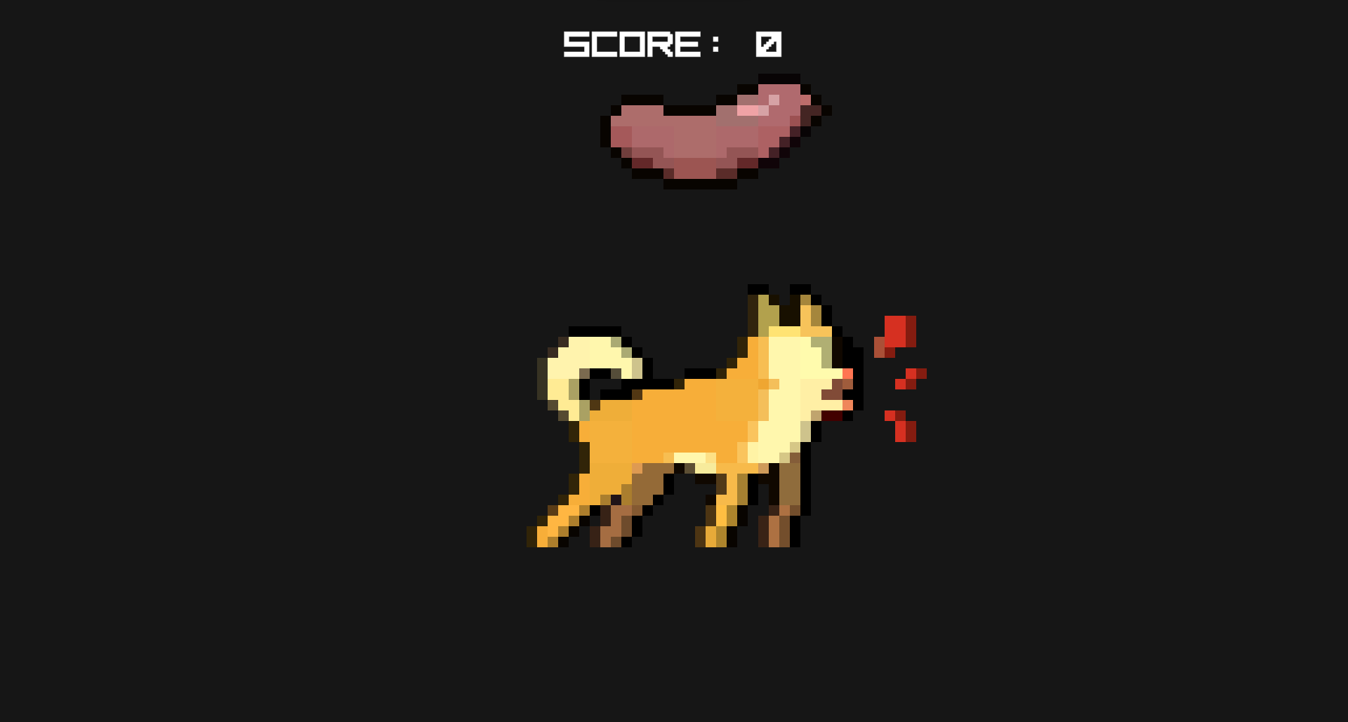
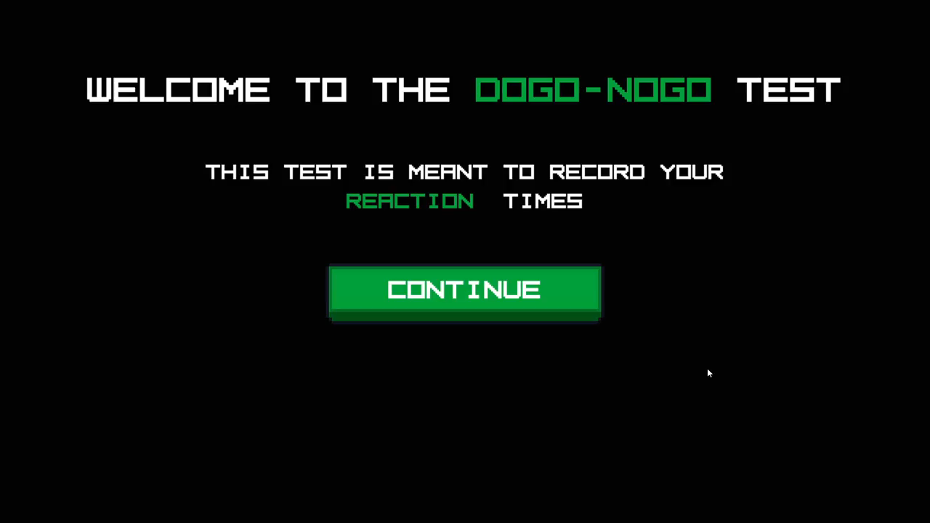

Slide 30
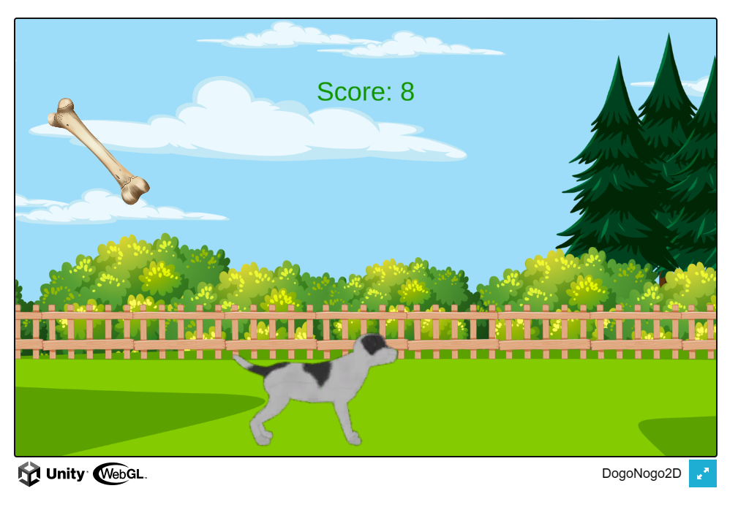
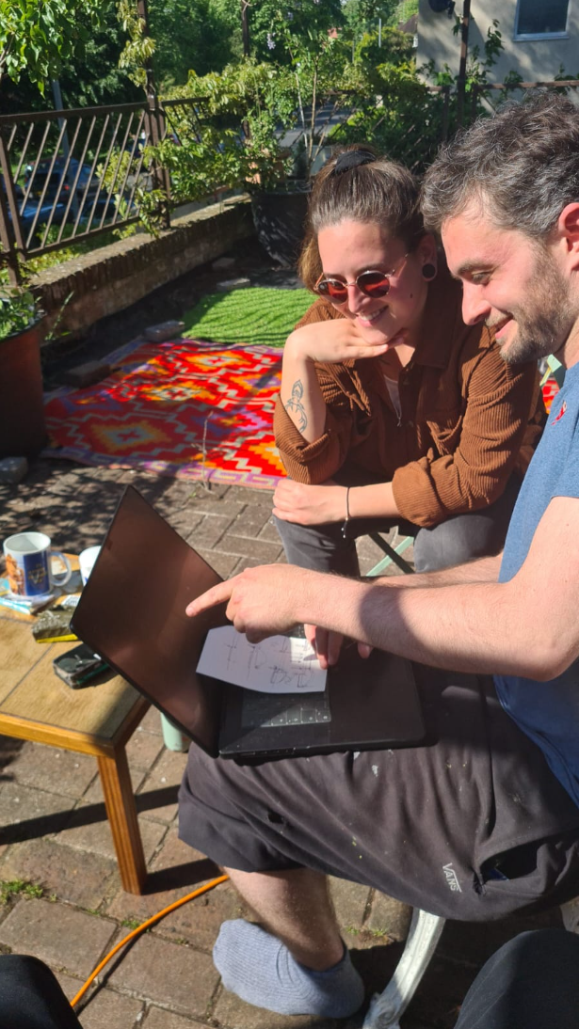

Slide 31
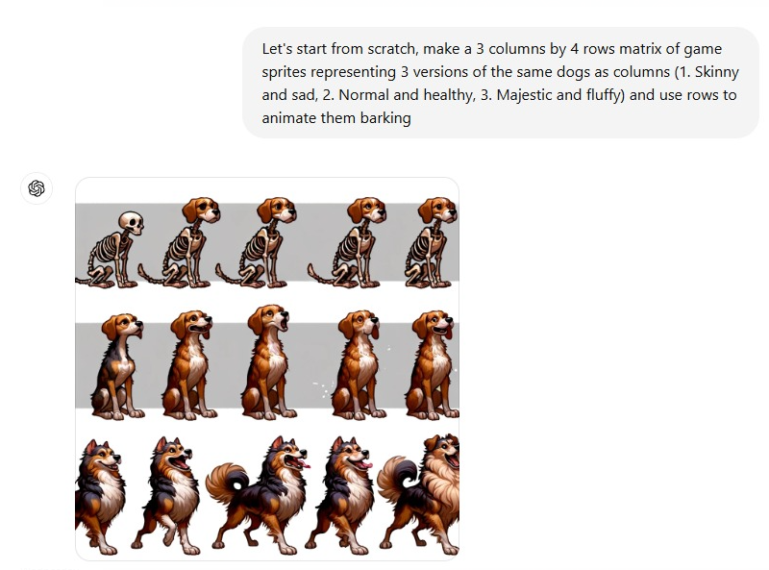
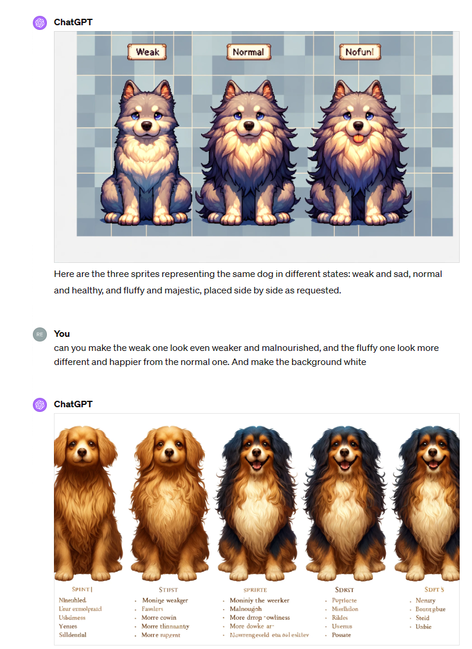
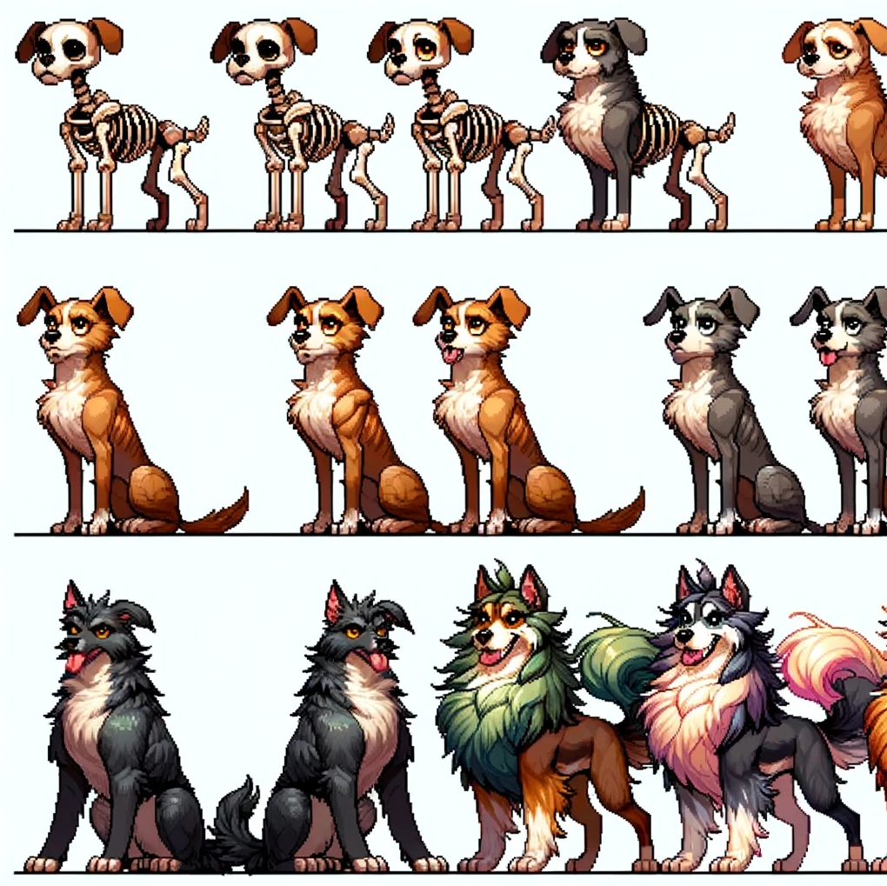

Slide 32


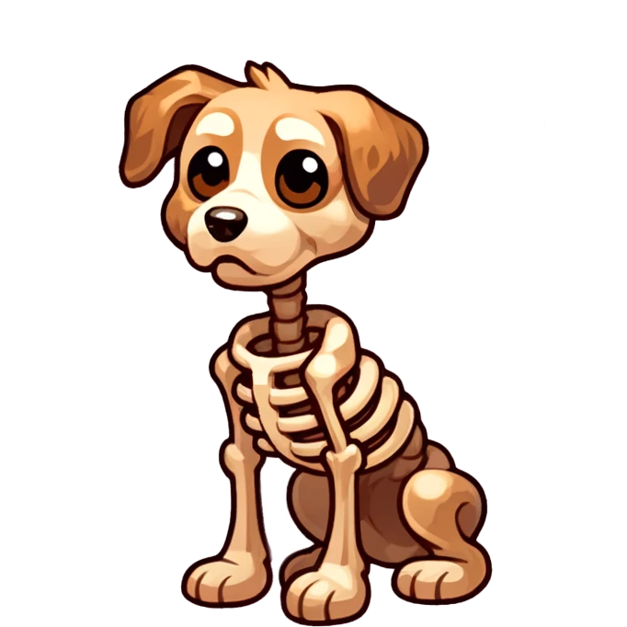

Doggo / Nogo
This game was designed by psychologists to accurately assess your cognitive reflexes. After each level, you will be told how well you did compared to others.
By playing, you agree that your data will be anonymously stored for scientific research. Read the full consent form [here]
Sound of cold metalic doors opening
Dog whining
You are an investigator tasked with bringing down criminals that mistreat animals.
During your last raid, your hear something.
You decide to take him home, and name him…
Ready?
Press ↓ to start
Doggo
Doggo is in need of urgent care and feeding.
Help him get as many bones as possible by pressing the down arrow (↓) as fast as possible.

Slide 33
Cognitive Statistical Models for
Computational Neuropsychology

Slide 34
Neuropsychology
Topic: Study of the relationship between the brain and behaviour
Method: Measurement of behaviour for inference about the brain
Domains: Fundamental (understanding the relationship) and Applied (i.e., clinical neuropsychology: usage of the knowledge to diagnose and rehabilitate cognitive deficits)
Problems:
Relies on outdated models of the brain
Relies on unreliable psychometric tools and paradigms
Relies on suboptimal quantification and classification methods
Computational Neuropsychology
New tasks that target specific cognitive processes based on newer brain theories
Using new computational approaches to estimating parameters
Example: Decision Making Models

